Slide 1
Running R on AWS

Slide 2
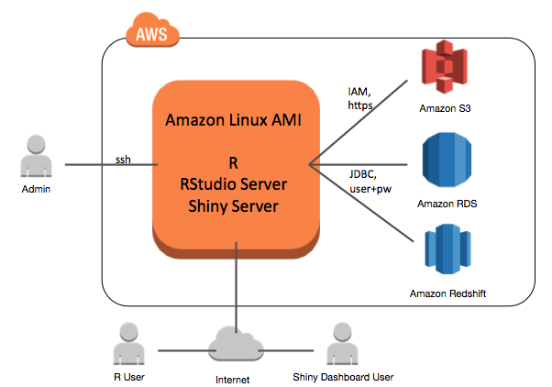

Slide 3
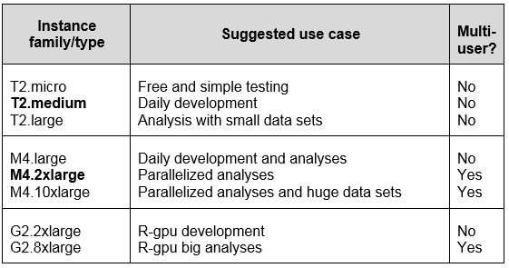
Choosing an Instance Type for R

Slide 4
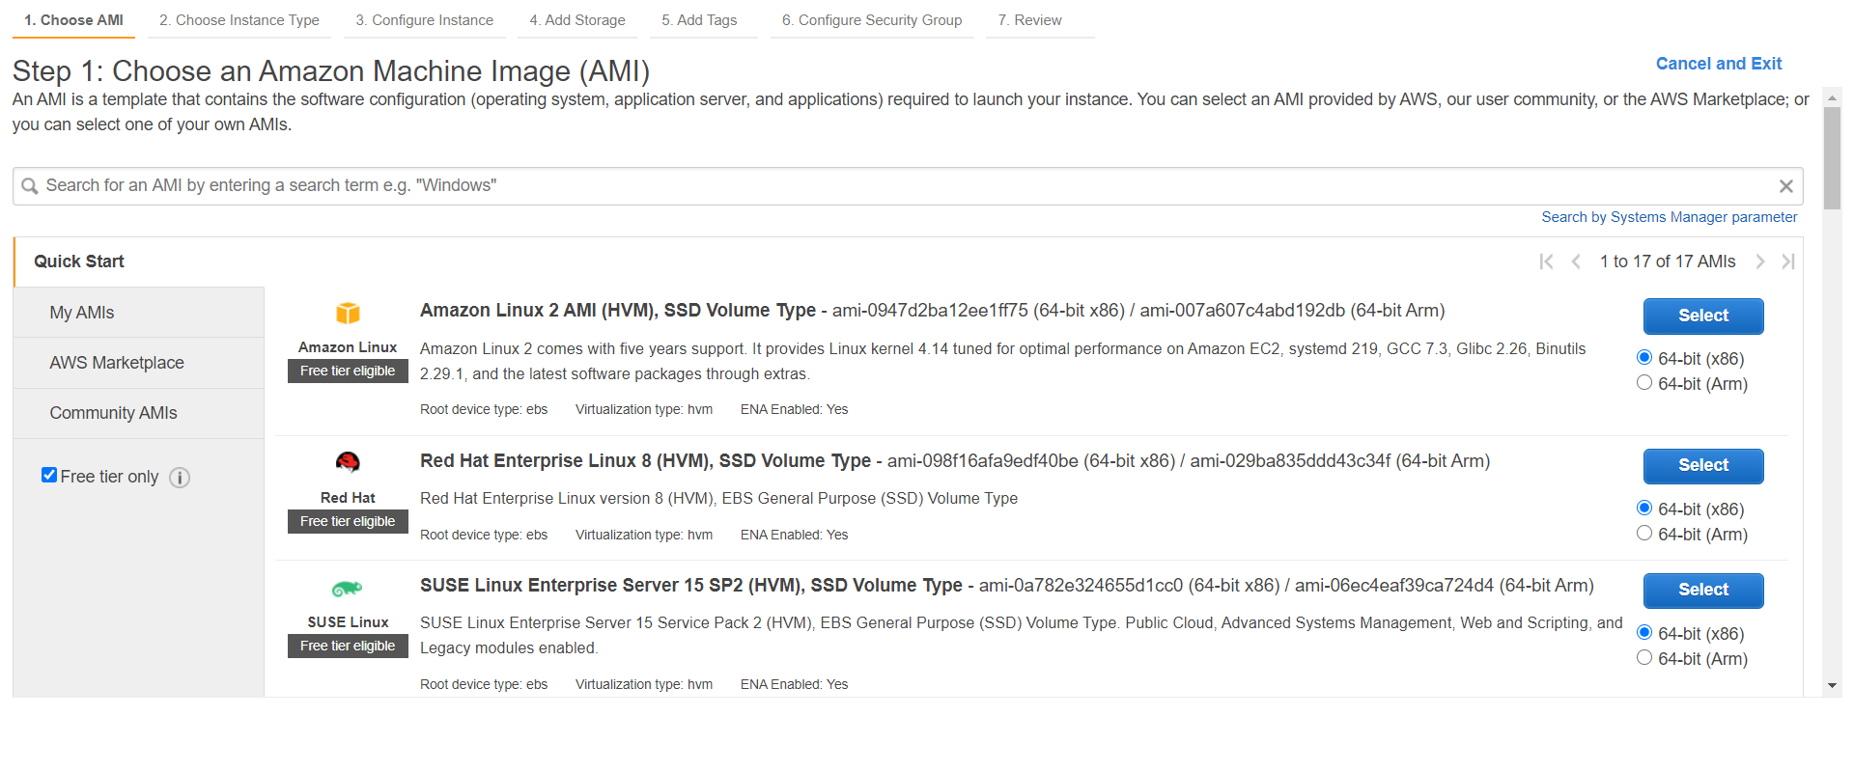

Slide 5
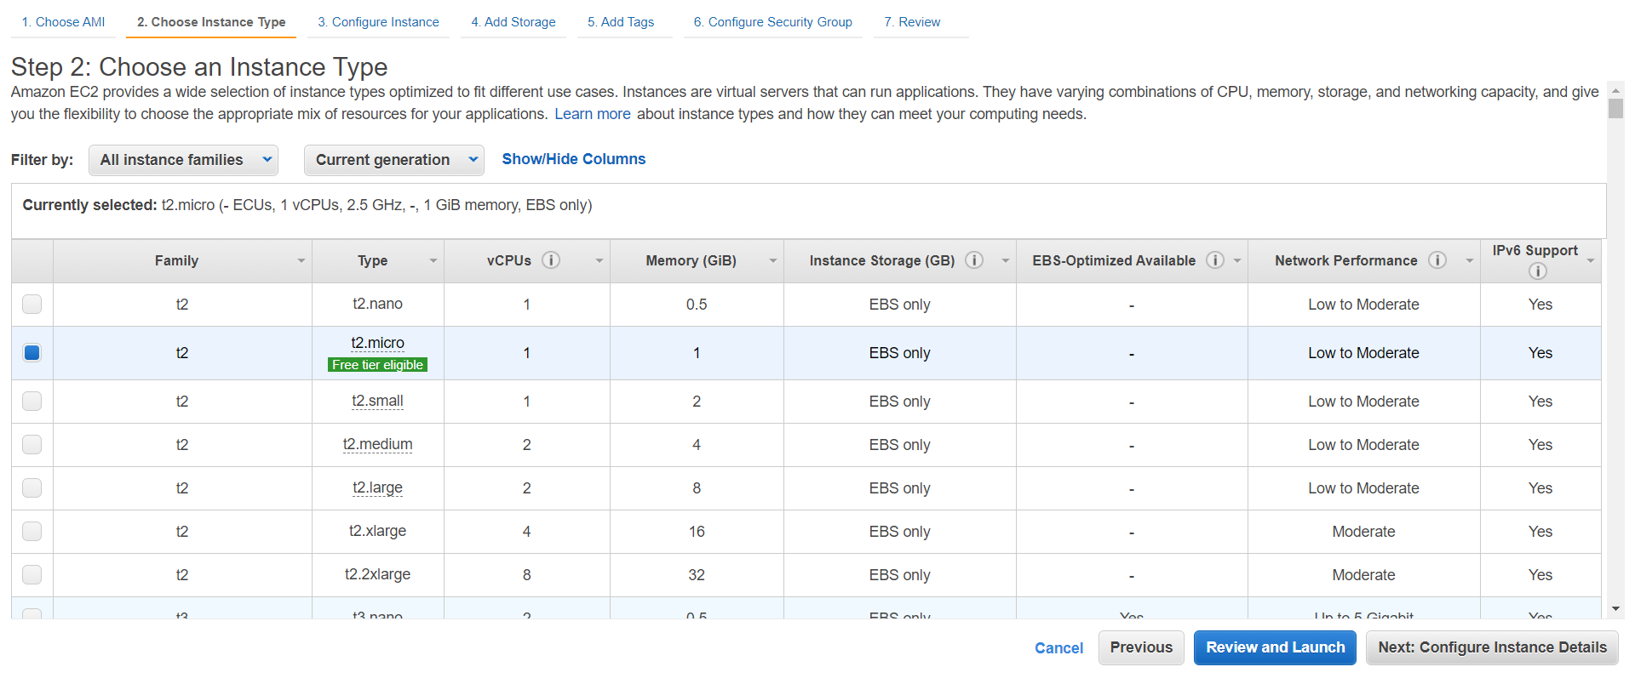

Slide 6
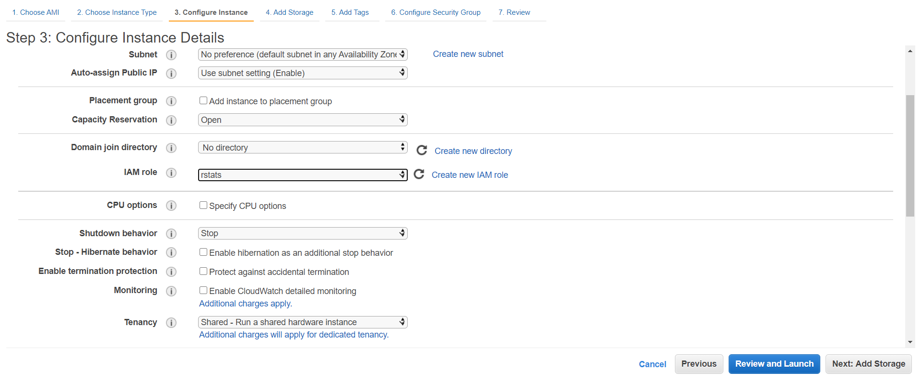

Slide 7
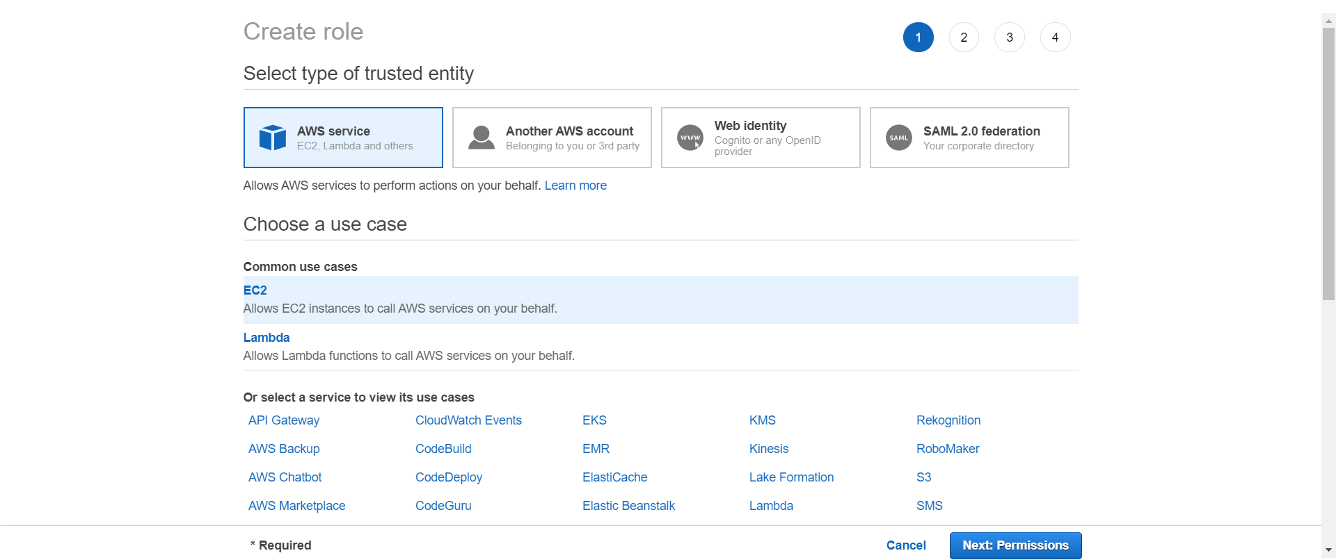

Slide 8
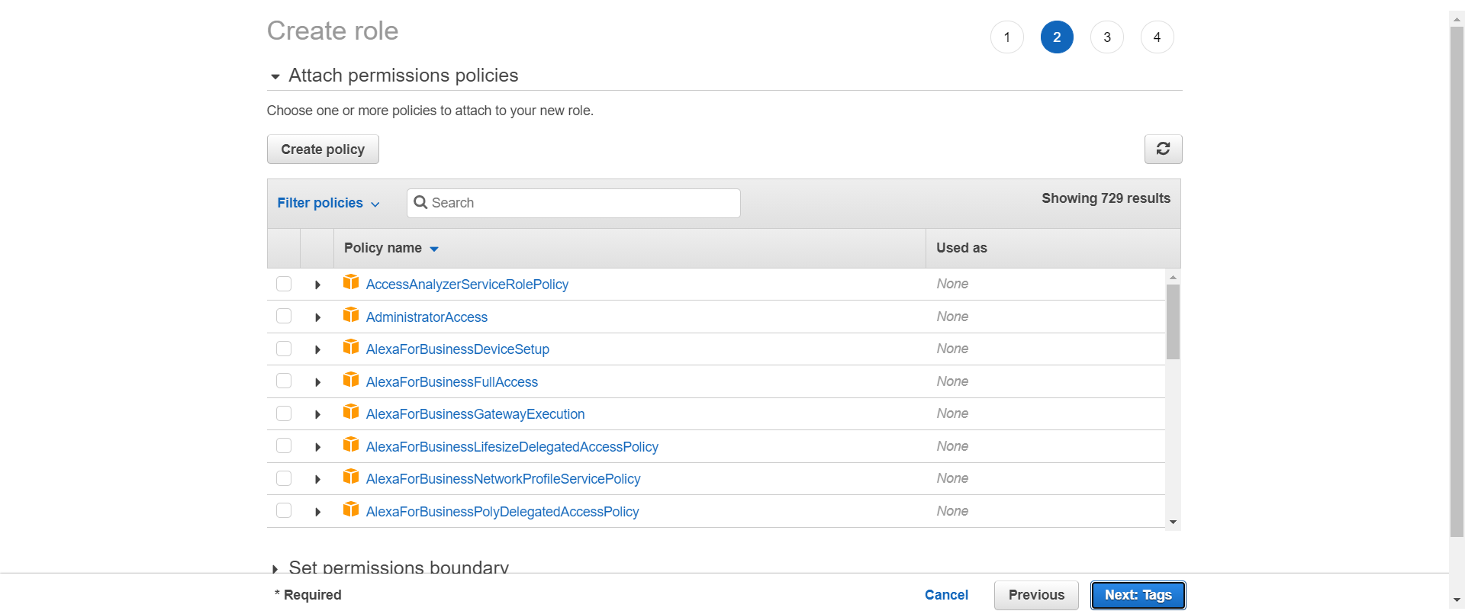

Slide 9
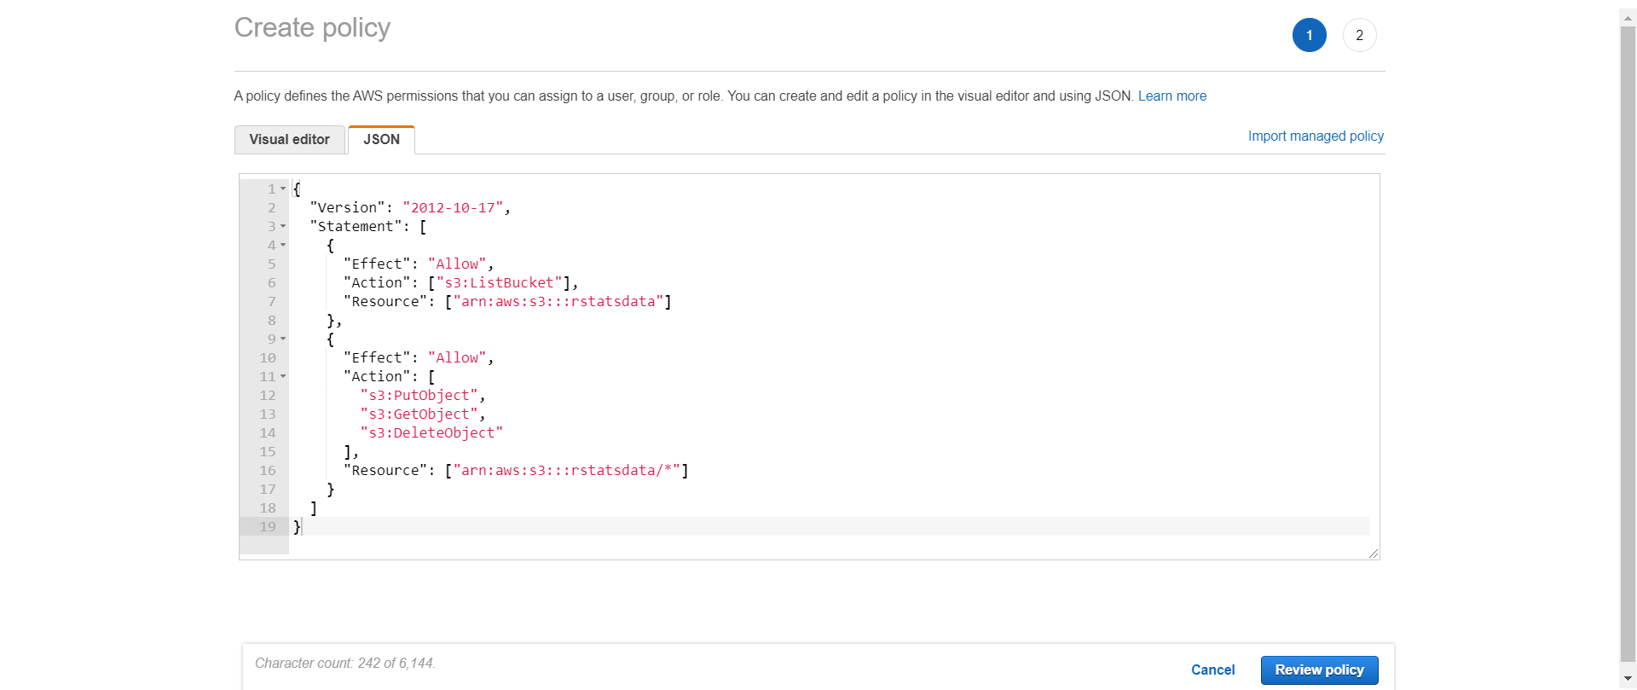

Slide 10
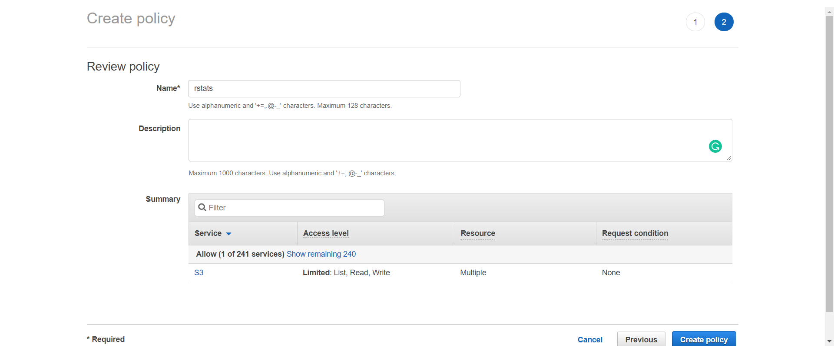

Slide 11
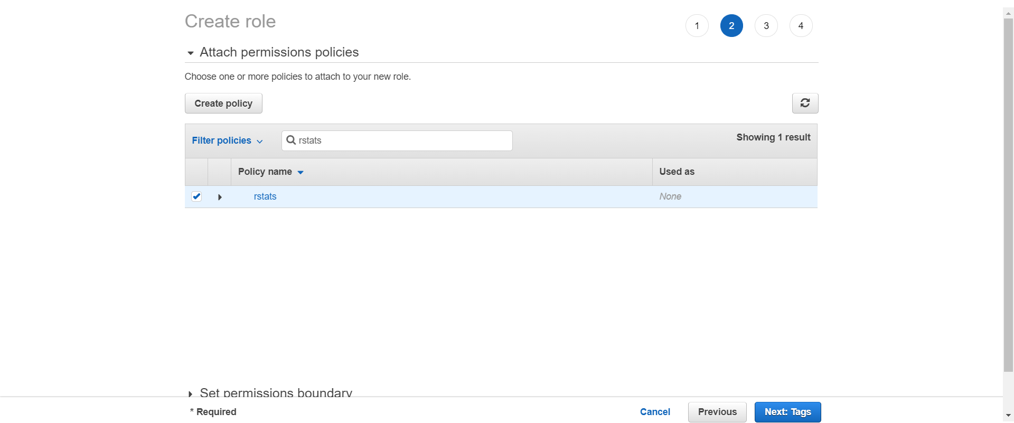

Slide 12
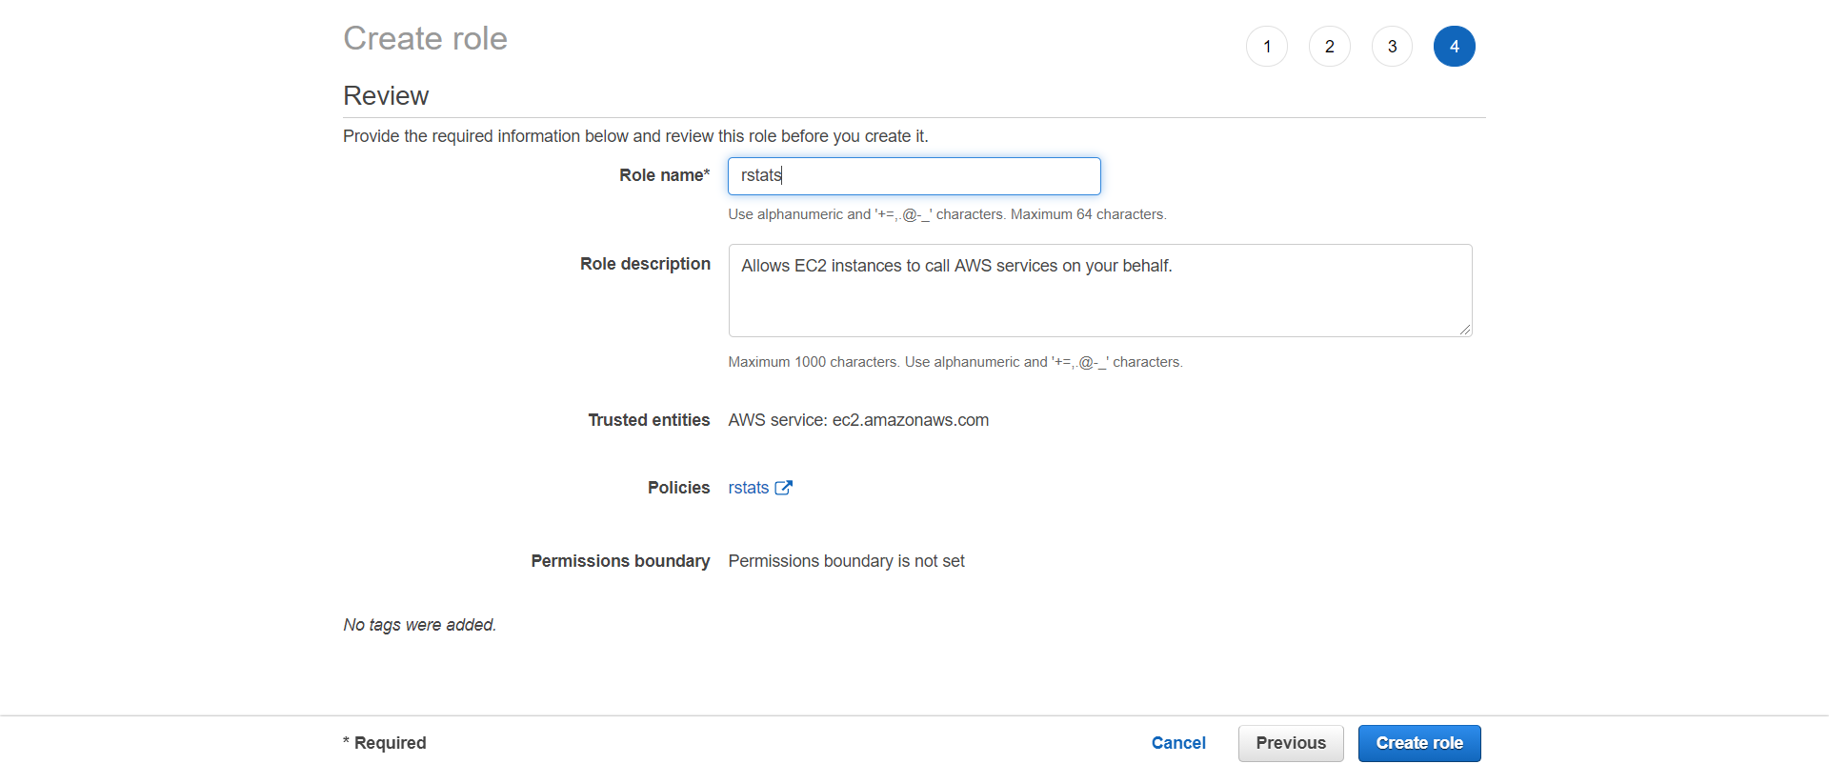

Slide 13
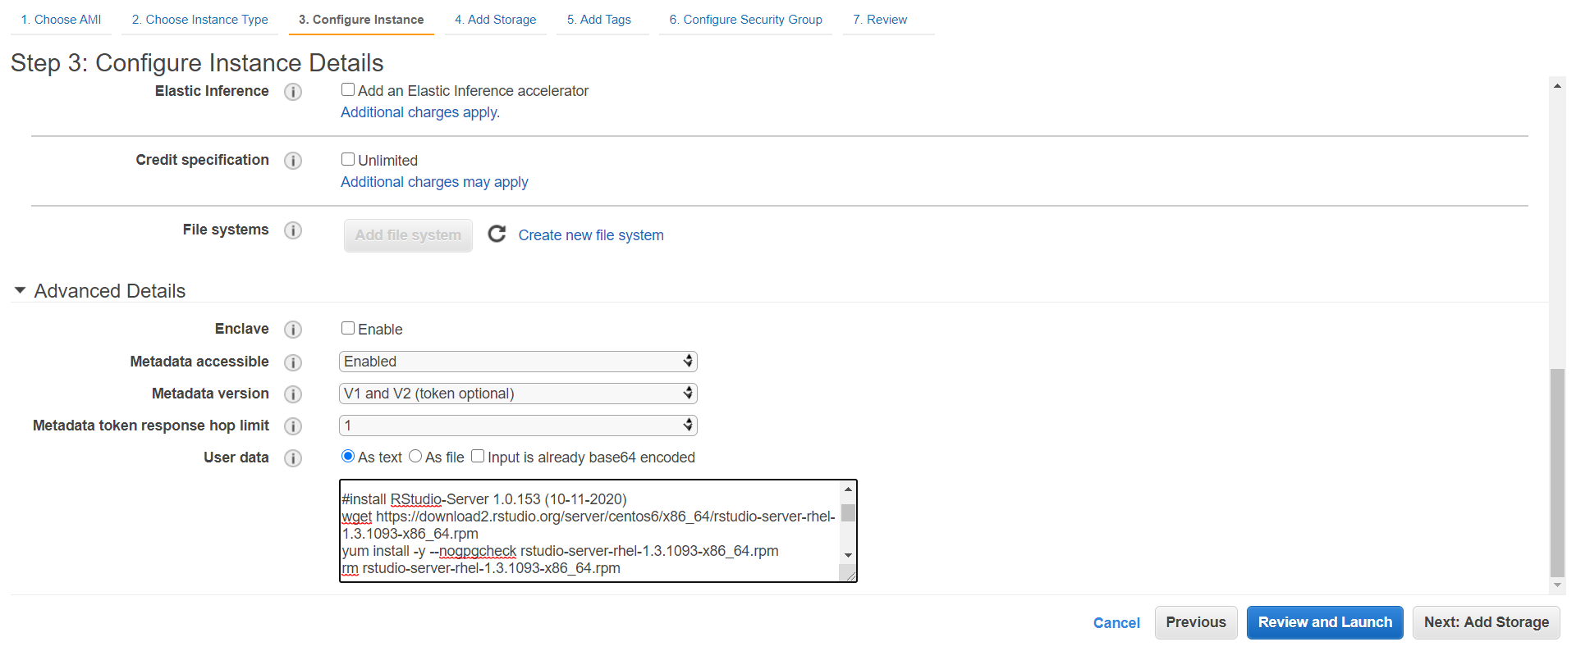

Slide 14
#!/bin/bash
#install R
amazon-linux-extras install R4 # or, yum install R for redhat/centos
#install RStudio-Server 1.0.153 (10-11-2020)
wget https://download2.rstudio.org/server/centos6/x86_64/rstudio-server-rhel-1.3.1093-x86_64.rpm
yum install -y --nogpgcheck rstudio-server-rhel-1.3.1093-x86_64.rpm
rm rstudio-server-rhel-1.3.1093-x86_64.rpm
#install shiny and shiny-server (10-11-2020)
R -e "install.packages('shiny', repos='http://cran.rstudio.com/', dependencies = TRUE)"
wget https://download3.rstudio.org/centos6.3/x86_64/shiny-server-1.5.14.948-x86_64.rpm
yum install -y --nogpgcheck shiny-server-1.5.14.948-x86_64.rpm
rm shiny-server-1.5.14.948-x86_64.rpm
#add user(s)
useradd ioa
echo ioa:11112020 | chpasswd

Slide 15
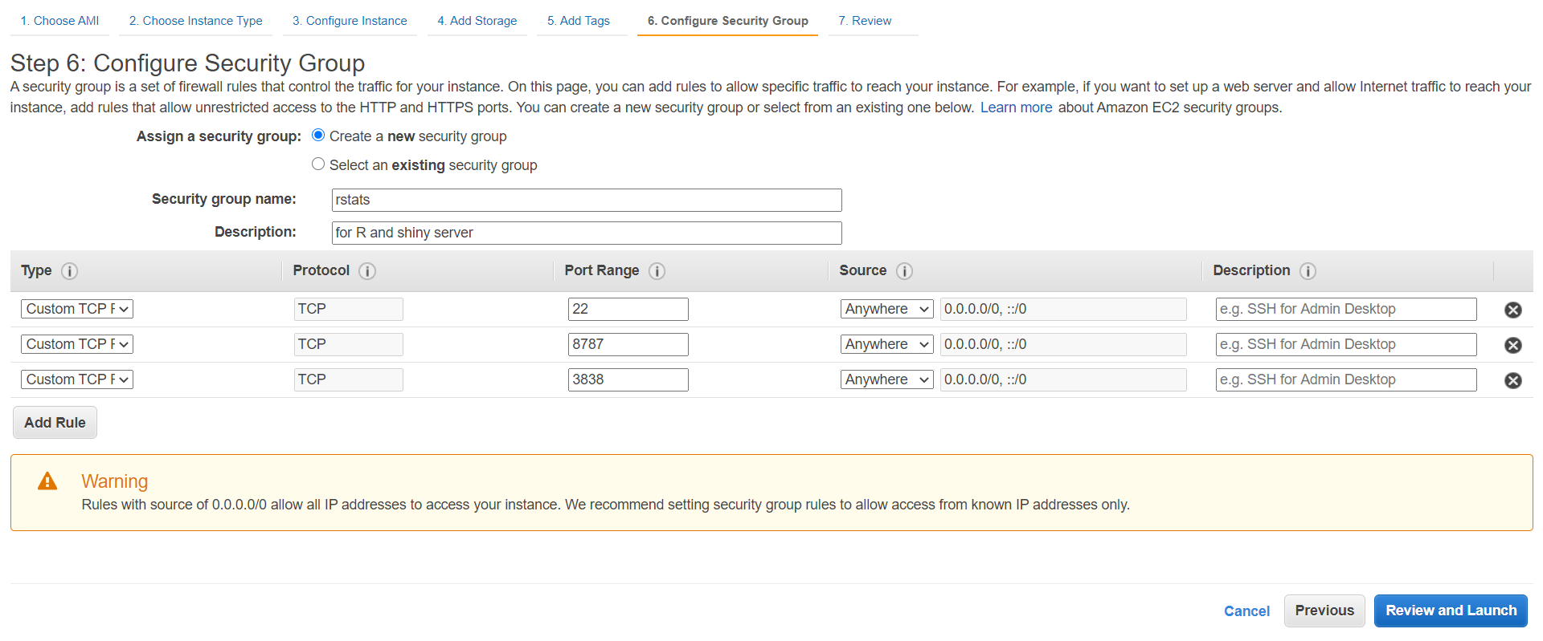

Slide 16
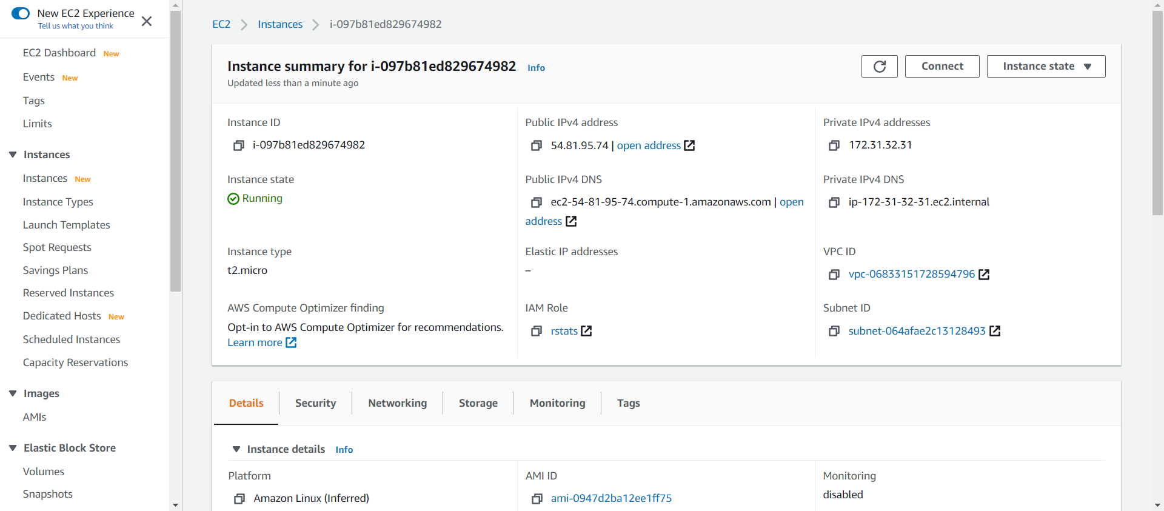

Slide 17
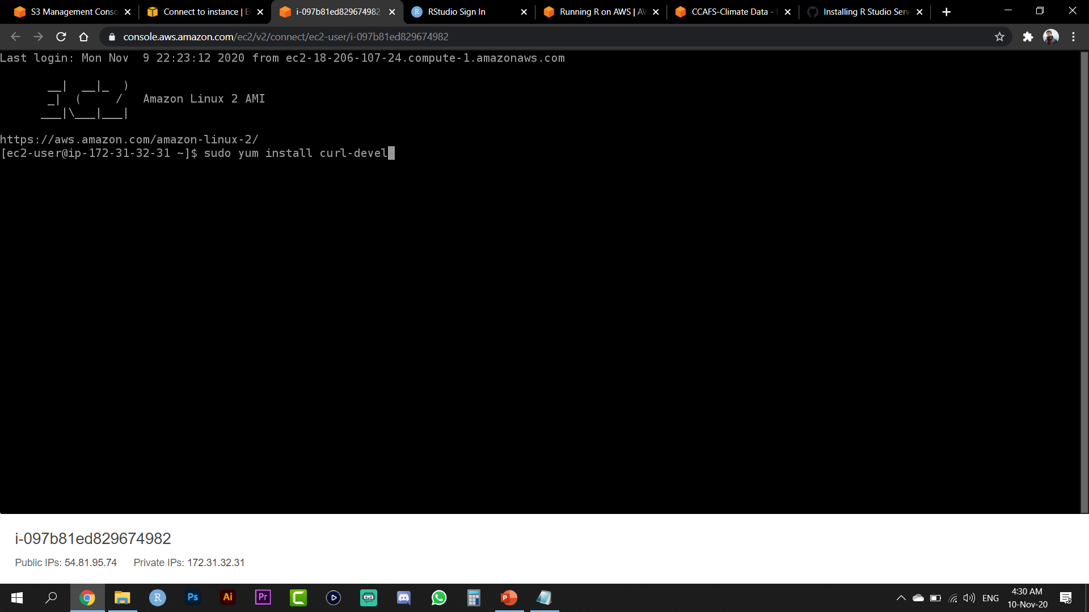

Slide 18
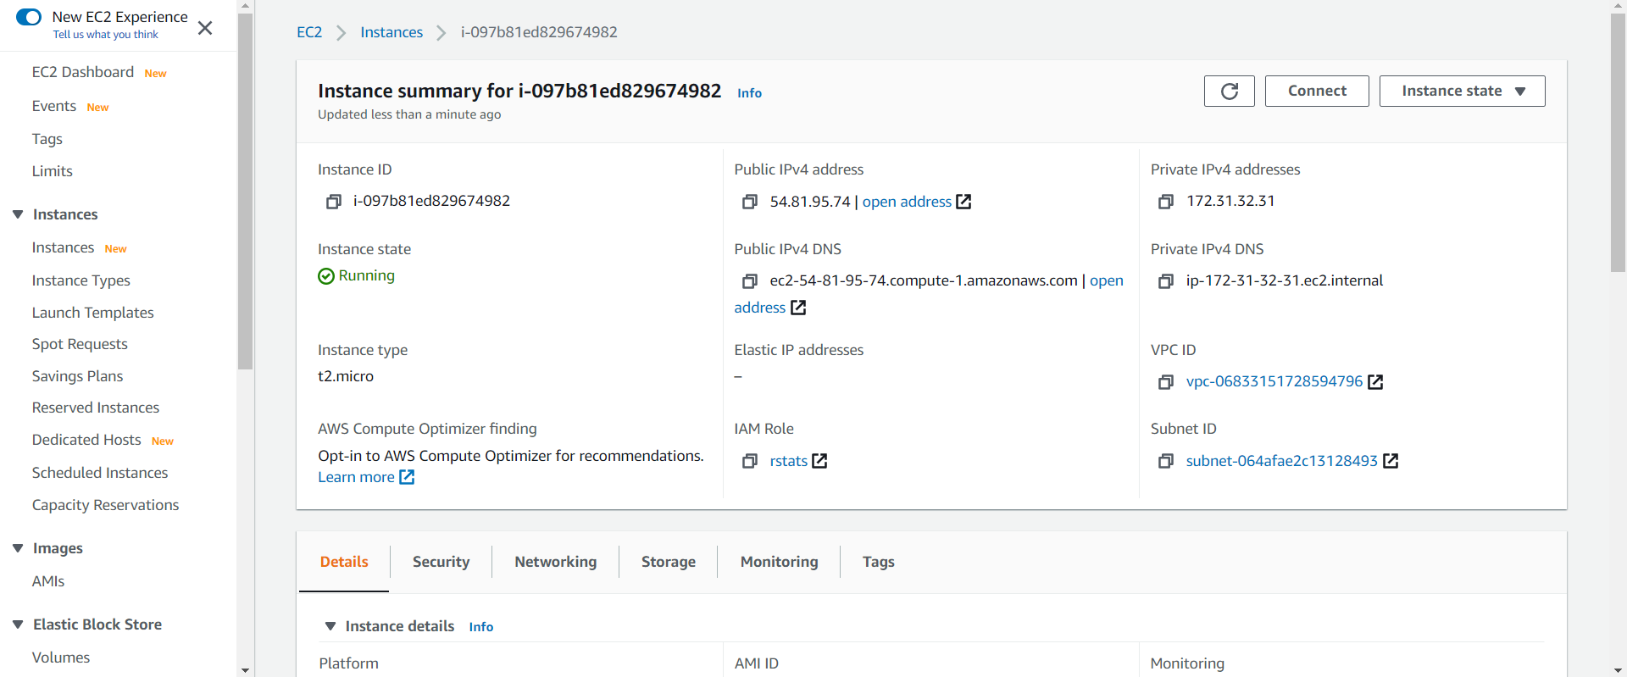

Slide 19
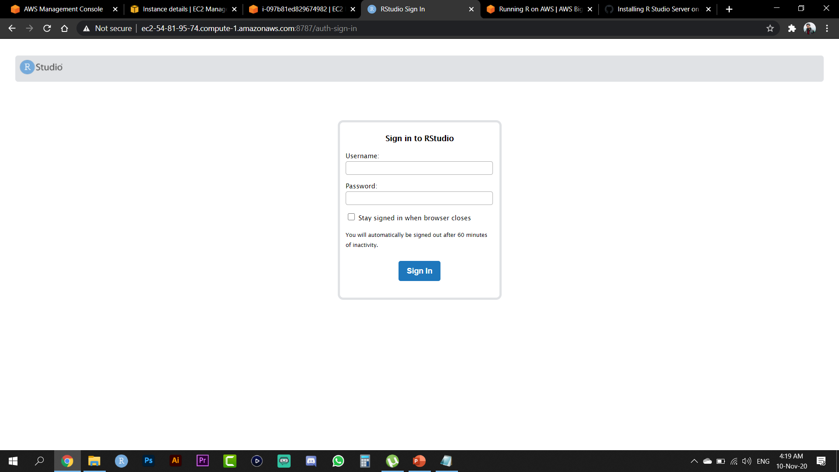
ioa
1111020

Slide 20
